Slide 1
Digital Portfolio
STUDENT NAME: HEMA M
REGISTER NO AND NMID:212401003/3FC93D55131D48A80404036AF77BE1A2
DEPARTMENT: COMPUTER APPLICATION
COLLEGE: UNIVERSITY OF MADRAS

Slide 2
PROJECT TITLE
DIGITAL PORTFOLIO USING FRONT END WEB DEVELOPMENT

Slide 3


AGENDA
Problem Statement
Project Overview
End Users
Tools and Technologies
Portfolio design and Layout
Features and Functionality
Results and Screenshots
Conclusion
Github Link
3/21/2024 Annual Review

Slide 4

PROBLEM STATEMENT
In today’s competitive digital era, having a professional online presence is essential for students and professionals to showcase their skills, achievements, and projects. Traditional resumes and certificates alone are not sufficient to demonstrate one’s capabilities effectively. There is a need for a digital portfolio that can serve as a personalized platform to highlight academic qualifications, technical skills, certifications, and project work in an organized and visually appealing manner.

Slide 5

PROJECT OVERVIEW
This digital portfolio is designed to represent my personal and academic profile in an organized way. It includes details about me, my educational background, certificates I have earned, my skills, and my contact information. The portfolio acts as a platform to present my achievements and abilities to future opportunities.

Slide 6

WHO ARE THE END USERS?
The end users of my digital portfolio are mainly recruiters, employers, and academic professionals who seek to evaluate my qualifications and skills in an organized manner. It also serves teachers and mentors who guide me in my learning journey and want to track my growth. Fellow students and peers can also use the portfolio to understand my strengths and collaborate on future projects. Additionally, industry experts and professionals may refer to my portfolio to connect with me for opportunities. Overall, the portfolio is designed to be useful for anyone who wants to know about my academic background, certifications, abilities, and contact details in a professional way.

Slide 7

TOOLS AND TECHNIQUES
In this project, I used Visual Studio Code (VS Code) as the main development environment because it is simple, efficient, and supports multiple extensions for web development. The portfolio was created using HTML to structure the content, CSS to design and style the pages, and JavaScript to add interactive elements. VS Code made it easier to manage my code with features like syntax highlighting, debugging, and live server preview. I also applied design techniques such as responsive layout, color themes, and proper typography to make the portfolio attractive. These tools and techniques together helped me build a well-organized and professional digital portfolio.

Slide 8
POTFOLIO DESIGN AND LAYOUT
The design and layout of my digital portfolio are kept simple, clean, and user-friendly to ensure easy navigation. The homepage introduces the About Me section, followed by structured pages for Education, Certificates, Skills, and Contact Information. A consistent color scheme, readable fonts, and proper spacing were used to give the portfolio a professional look. The layout is responsive so that it adjusts well on desktops, tablets, and mobile devices. Overall, the design focuses on clarity and professionalism while reflecting my personal style.
8

Slide 9
FEATURES AND FUNCTIONALITY
The digital portfolio provides a clear and structured way to present my personal and academic information. It includes dedicated sections such as About Me, Education, Certificates, Skills, and Contact, making it easy for viewers to explore. The navigation menu allows users to move between sections smoothly, and the responsive design ensures that the portfolio works well on different devices. Visual elements and styling make the portfolio attractive, while proper organization enhances readability. Overall, the functionality ensures that anyone accessing the portfolio can quickly understand my profile and connect with me.

Slide 10
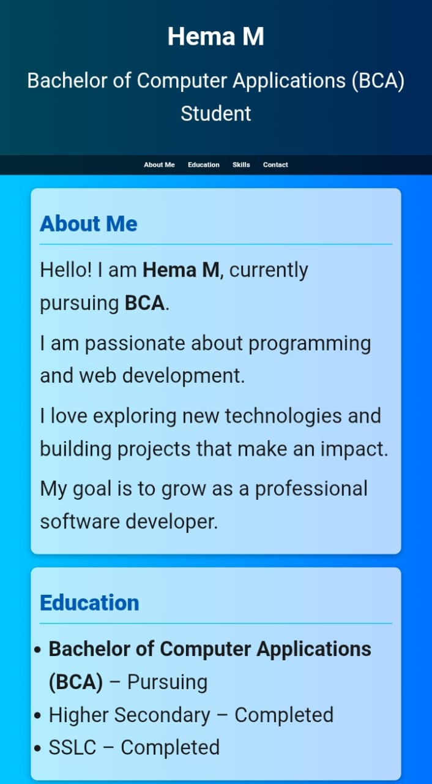

RESULTS AND SCREENSHOTS
The outcome of this project is a complete and interactive digital portfolio that clearly represents my personal details, education, certificates, skills, and contact information. The final portfolio is designed with a clean layout, consistent color scheme, and easy navigation, making it professional and user-friendly. It works smoothly across different devices, ensuring accessibility for all users.
3/21/2024 Annual Review
10

Slide 11
CONCLUSION
The digital portfolio successfully showcases my personal, academic, and professional details in a well-structured and appealing format. It brings together important sections such as About Me, Education, Certificates, Skills, and Contact into a single platform. By using VS Code along with HTML, CSS, and JavaScript, the portfolio was designed to be interactive and user-friendly. The project helped me apply my technical knowledge while also improving my design and presentation skills. Overall, the portfolio acts as a professional representation of my identity and a useful tool for future opportunities.
11

Slide 12
GITHUB LINK
https://hemam-byte.github.io/Hema-M/

